Slide 1
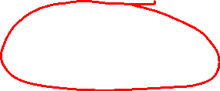
Section 11.10 Taylor and Maclaurin Series
Lecture 2
Taylor's Theorem

Slide 2
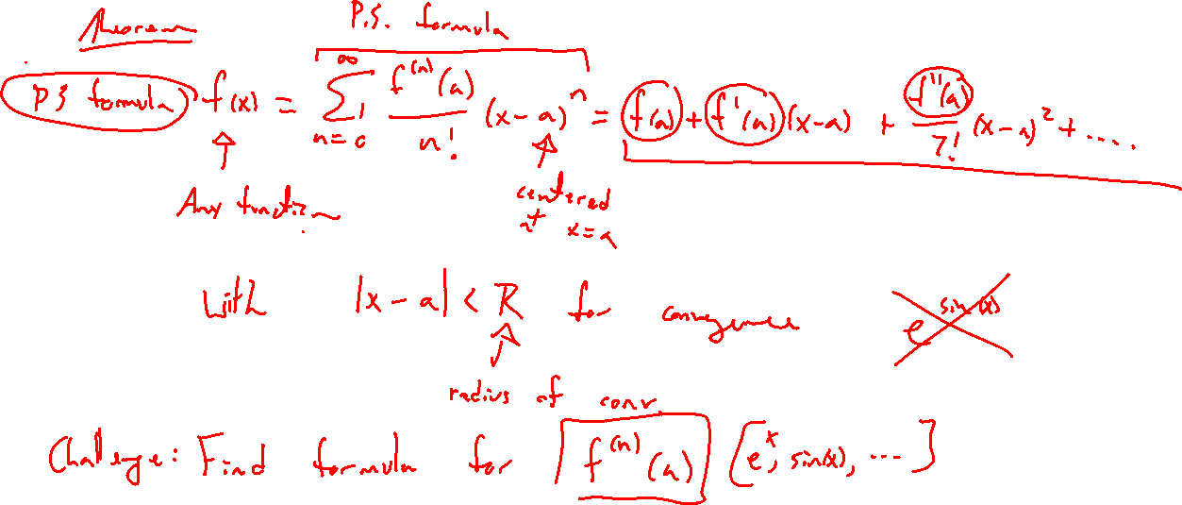
Reminder: Taylor Series
Notes:
Question: If we only look at the first 3 terms, how accurate is it?

Slide 3
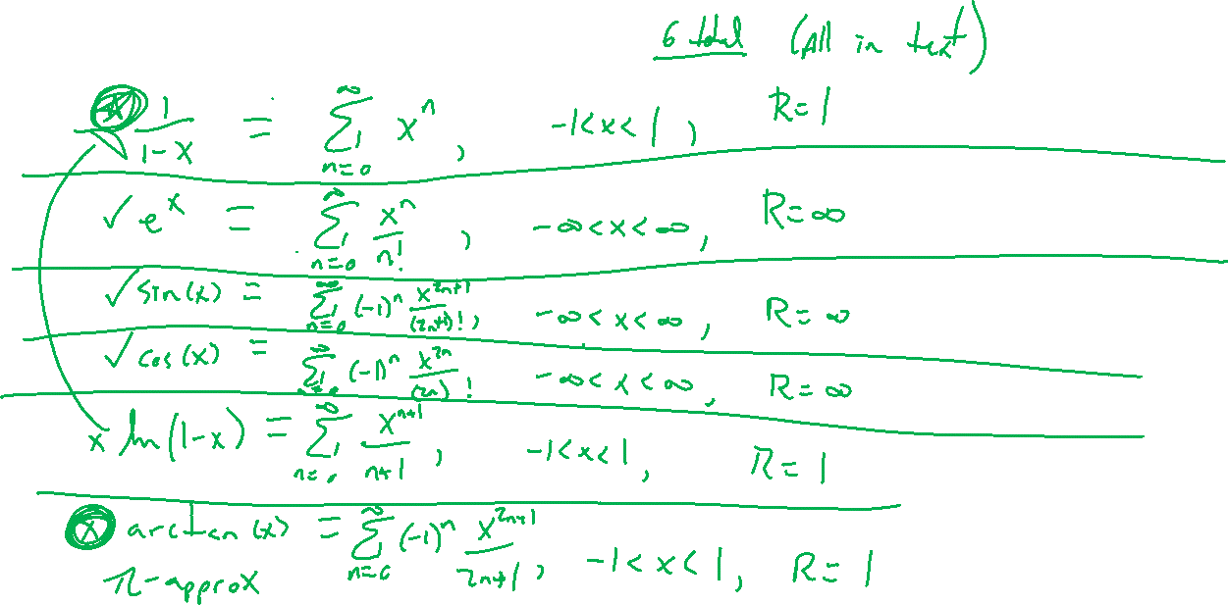
Power Series Formulas
Notes:
E^x, sin(x), cos(x), 1/(1-x), ln(1-x)
Mention can try Taylor's formula for last two to see agree
Desmos demo for first 3

Slide 4
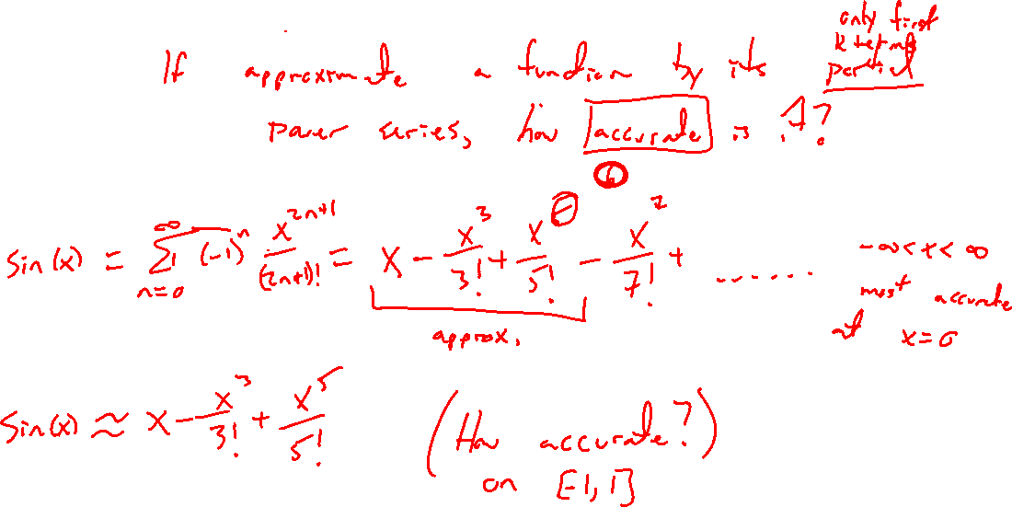
Example:
Notes:
Sin(x) taylor series centered at a=0
Sin(x) ~ x-x^3/3! + x^5/5! (degree 6 approximation)
How good is the accuracy?
Desmos plot

Slide 5
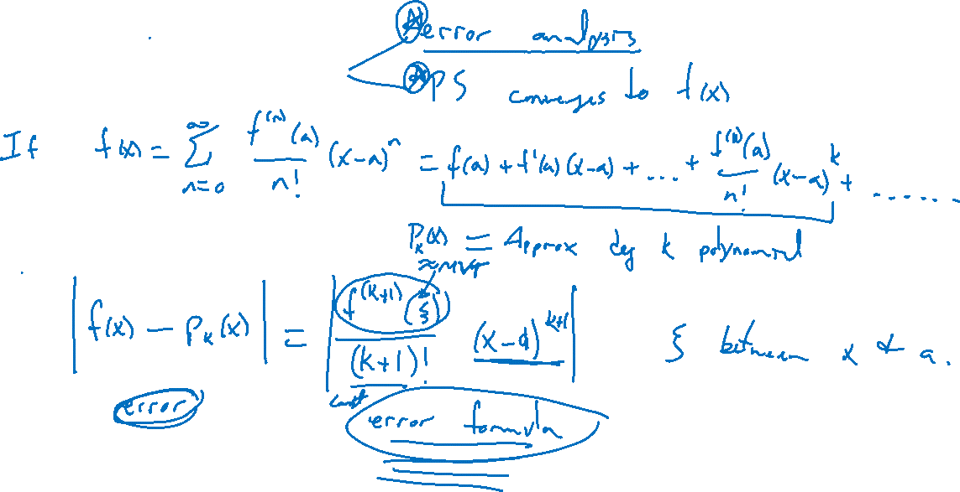
Taylor's Theorem

Slide 6
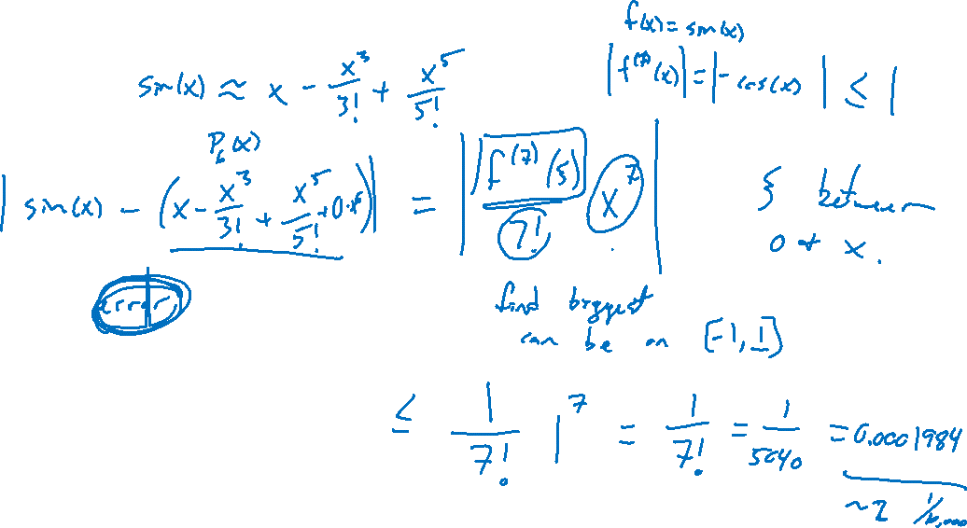
Example:
Notes:
Sin(x) taylor series centered at a=0
Sin(x) ~ x-x^3/3! + x^5/5! (degree 6 approximation)
How good is the accuracy? On interval [-½ , ½ ]
Desmos plot
Taylor series in action: https://en.wikipedia.org/wiki/Newton%27s_method

Slide 7

Section 11.10 Examples and Homework
Rework textbook examples: 3, 6, 7, 8, 9
Write down problem.
Close book and attempt on own.
Compare your solution to text solution, improve your writing.
Exercises: 5, 7, 11, 19, 35, 37, 49

Slide 8

Section Homework Submission to Canvas
Preview of section​
Skim section, write short paragraph summary, list all important definitions / theorems / formulas.​
Notes on video lectures​
Include all details, worked examples, your own thoughts​
Worked examples from text​
Solutions to exercises​
Final reflection of section​
List of key takeaways to remember​

